Slide 1


GridSE: Towards Practical Secure Geographic Search via Prefix Symmetric Searchable Encryption
AISecLab
Ruoyang Guo, Jiarui Li, Shucheng Yu
August 16, 2024

Slide 2








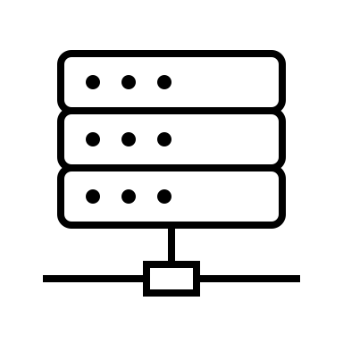




Geographic Search (GS) on sensitive data
GS apps need to collect personal information
– users’ real-time locations
(GS app)
Client -
Server-
(cloud)
A Map of Users
outsourced
…
search token
results
…

Slide 3
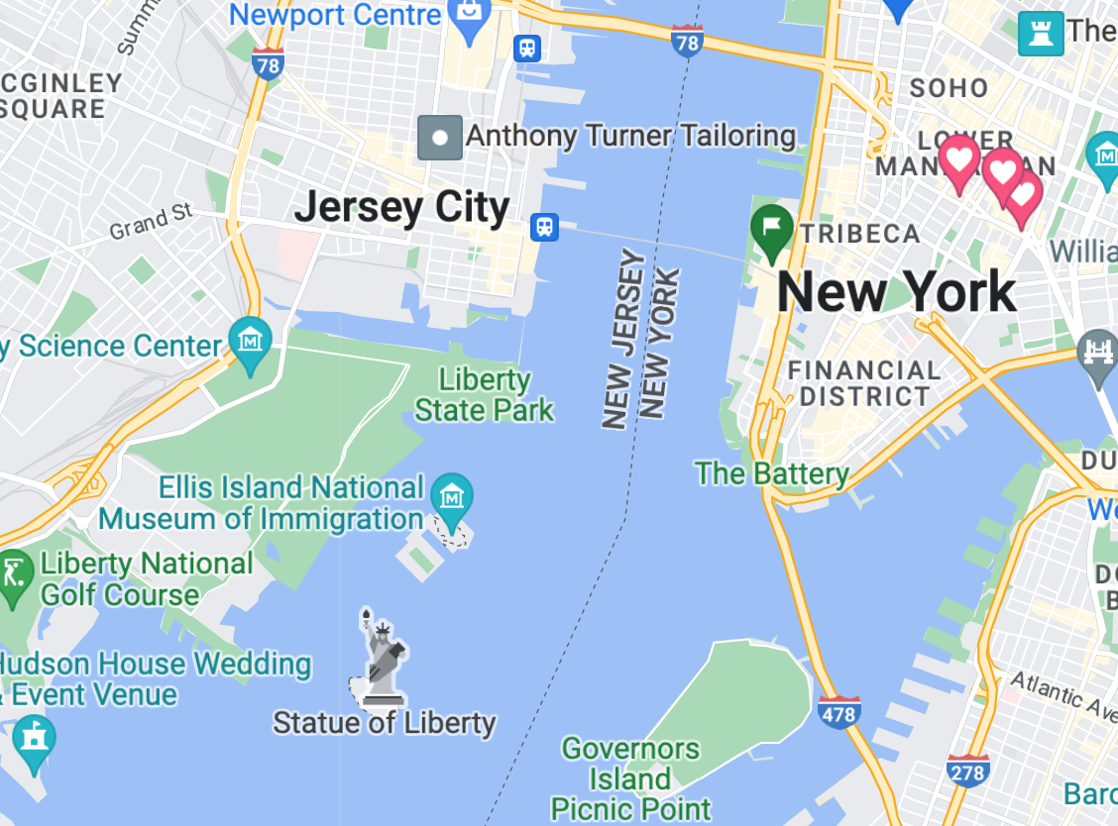
Compatibility with Discrete Global Grid Systems
Existing GS Apps have been deeply rooted in DGGS
Geohash, Google S2, Uber H3, etc.
A tourist: “ Best place to visit in New Jersey? ”
Search Result: “ Statue of Liberty”
“d r 5 r”
“dr5r7”
A Secure Geographic Search (SGS) app needs a Secure Prefix Search!

Slide 4
SGS Design Objectives
Near latency-free instant response
Compatibility with DGGS
Searchable Encryption for prefix (pSSE)
Dynamic Search
GS database updates: add or delete entries
Forward Privacy: newly added data cannot be linked to previous queries
Backward Privacy: a query cannot be linked to previously deleted data

Slide 5
State of The Art
Dynamic SSE only supports the whole keyword search
Secure Substring Search
Tradeoff between update, efficiency, security and false-positive rate
Directly constructing SGS with existing primitives is difficult.

Slide 6




















Our Design
1) SP^2E : To evaluate whether a keyword contains a given prefix
d
r
5
r
$${H(sk}_{d}∥seq∥1)$$
$$f$$
0 | $${H(sk}_{r}∥seq∥2)$$
$$k^{′}=$$
$$⊕$$
$$2f$$
0… | $${H(sk}_{5}∥seq∥3)$$
$$3f$$
“dr5r”
0…0 | $${H(sk}_{r}∥seq∥4)$$
$$⊕$$
$$δ({pos}_{1},{pos}_{2})$$
Server
d
r
5
r
7
$${H(sk}_{d}∥seq∥1)$$
$$f$$
0 | $${H(sk}_{r}∥seq∥2)$$
“dr5r7”
$$2f$$
$$ct=$$
$$⊕$$
0… | $${H(sk}_{5}∥seq∥3)$$
$$3f$$
0…0 | $${H(sk}_{r}∥seq∥4)$$
$$4f$$
0…0 | $${H(sk}_{7}∥seq∥5)$$
$$δ$$
$$offset$$
$$0^{f}$$

Slide 7


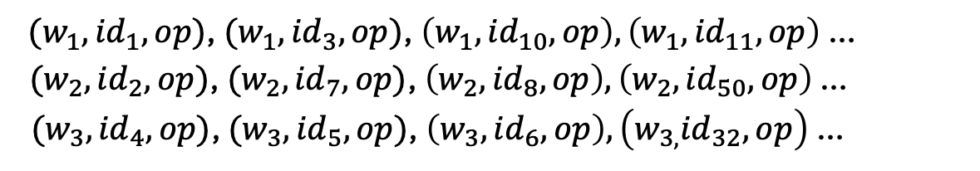

Our Design
2) Forward/Backward Privacy : To prevent updates from leaking information
A triplet of (w, id, op)
w: keyword
id: files/entries/records in the database
op: deletion or addition
- A dictionary map, key-value pair
2 counters for encryption:
UpdtCnt – stores the update times occurred on files under index-key/addr w
Seq -- the dictionary sequence of Addr
Addr ：
Val
SP^2E
$$w_{1} :$$
$$w_{2} :$$
$$w_{3} :$$
$(w_{1}, {id}_{1}, op)$, $(w_{1}, {id}_{3}, op)$, $\left({w_{1},id}_{10}, op\right),\left(w_{1}, {id}_{11}, op\right)$ …
$({w_{2}, id}_{2}, op)$, $(w_{2}, {id}_{7}, op)$, $\left({w_{2}, id}_{8}, op\right),\left(w_{2}, {id}_{50}, op\right)$ …
$(w_{3}, {id}_{4}, op)$, $({w_{3}, id}_{5}, op)$, $\left(w_{3}, {id}_{6}, op\right),\left({w_{3,}id}_{32}, op\right)$ …

Slide 8
Our Design
3) A generic framework transforming a dynamic SSE into a dynamic prefix SSE
Keep the basic setting and processing flow of GridSE
- secret keys storage/arrangement
Follow the dictionary structure
- key on prefix search
- value on other generic dynamic SSE methods

Slide 9
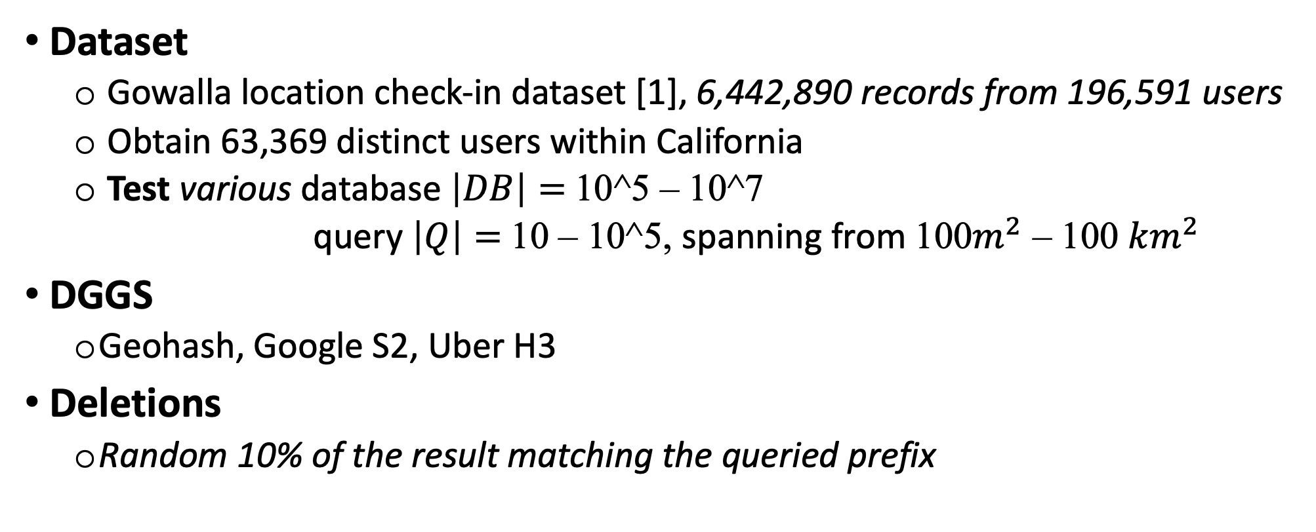
Evaluation
Dataset
Gowalla location check-in dataset [1], 6,442,890 records from 196,591 users
Obtain 63,369 distinct users within California
Test various database $\left|DB\right|=$ 10^5 – 10^7
query $\left|Q\right|=$ 10 – 10^5, spanning from 100$m^{2}$ – 100 ${km}^{2}$
DGGS
Geohash, Google S2, Uber H3
Deletions
Random 10% of the result matching the queried prefix

Slide 10

Evaluation
Search time
- with/without deletions
Fixed $\left|DB\right|=$ 10^6, |Q| = 10^4

Slide 11
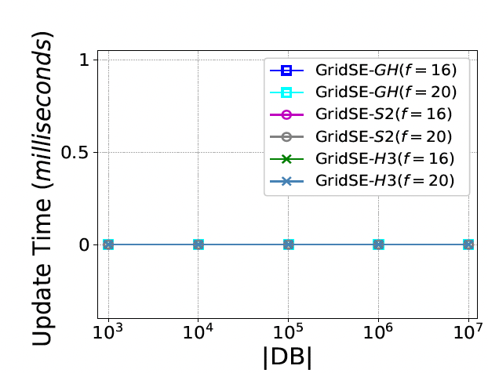
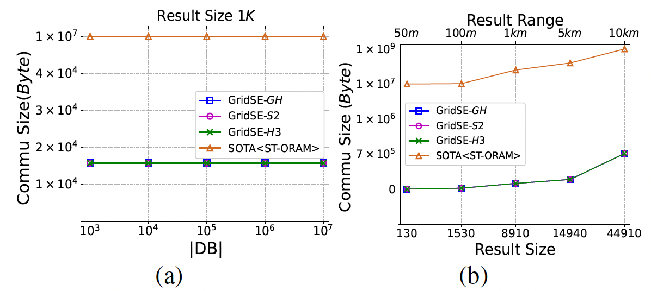
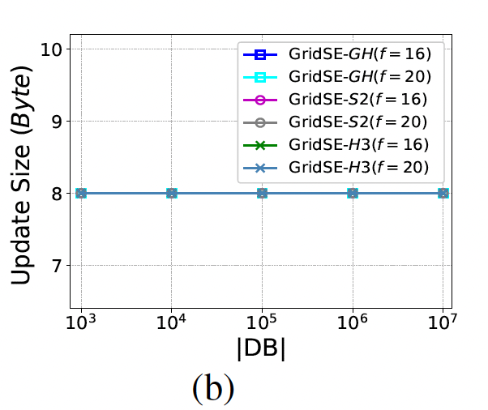
Evaluation
Communication
Update

Slide 12
Conclusion
GridSE A dynamic prefix SSE scheme
- Fast SGS with updates
- Backward and forward privacy
SP^2E A new crypto primitive
Performance
150X -5000X speedup in search time, 99% saving in communication cost than SOTA
1.4X more computation cost and 0.9X more communication overhead than plaintext search

Slide 13
Q & A
Contact
Ruoyang Guo
gruoyang@stevens.edu

